Slide 1
Chapter 3
Discrete Random Variables
and
Their Probability Distributions

Slide 2
Objectives
Discrete Distributions
Hyper-geometric

Slide 3
The Hypergeometric Distribution
The assumptions leading to the hypergeometric distribution are as follows:
1. The population or set to be sampled consists of N individuals,
objects, or elements (a finite population). 2. Each individual can be characterized as a success (S) or a failure
(F), and there are M successes in the population. 3. A sample of n individuals is selected without replacement in such
a way that each subset of size n is equally likely to be chosen.

Slide 4
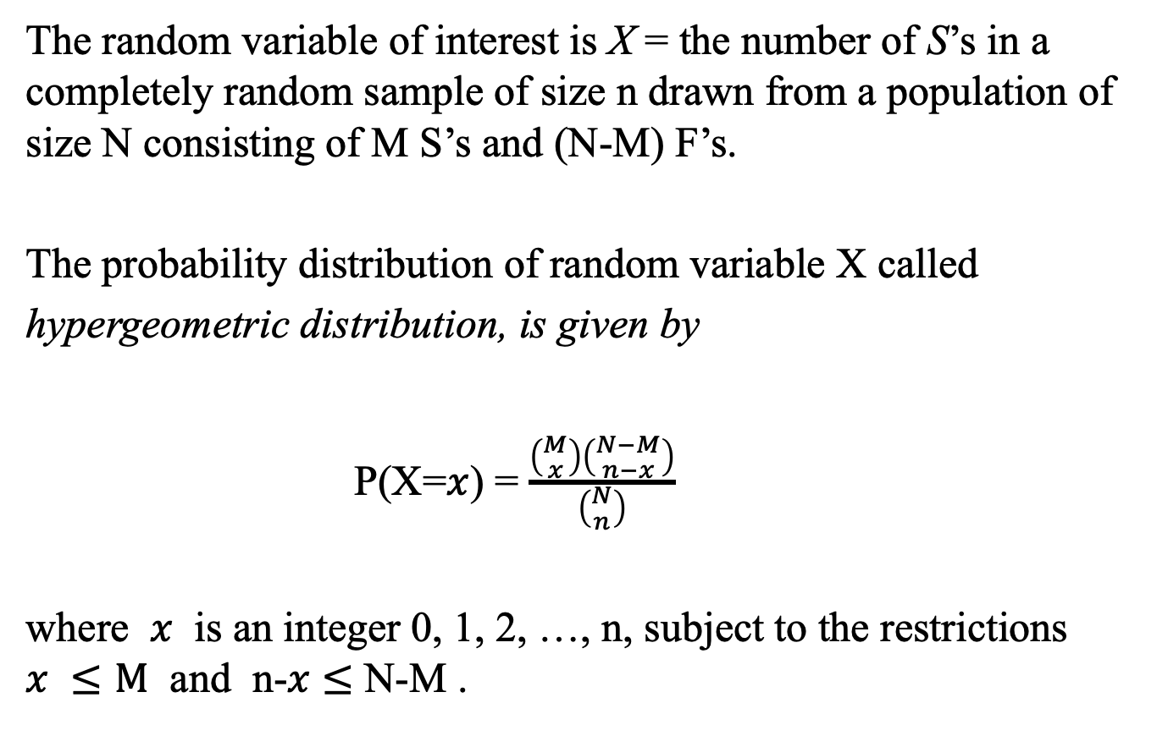
The Hypergeometric Distribution
The random variable of interest is X = the number of S’s in a completely random sample of size n drawn from a population of size N consisting of M S’s and (N-M) F’s.
The probability distribution of random variable X called
hypergeometric distribution, is given by
P(X=$x$) = $\frac{\left({M \atop x}\right)\left({N−M \atop n−x}\right)}{\left({N \atop n}\right)}$
where $x$ is an integer 0, 1, 2, …, n, subject to the restrictions $x ≤M$ and n-$x$ $≤$ N-M .

Slide 5

Example
During a particular period a university’s information technology office received 20 service orders for problems with printers, of which 8 were laser printers and 12 were inkjet models.
A sample of 5 of these service orders is to be selected for inclusion in a customer satisfaction survey.
What then is the probability that exactly x (x = 0, 1, 2, 3, 4,
or 5) of the selected service orders were for inkjet printers?

Slide 6

Example (cont’d)
Here n = 5, M = 12, and N = 20
Consider the value x = 2.
P(X = 2) = $\frac{number of outcomes having X=2}{number of possible outcomes}$
= $\frac{\left({12 \atop 2}\right) \left({8 \atop 3}\right)}{\left({20 \atop 5}\right)}$
= $\frac{77}{323}$
= 0.238

Slide 7
Example
5 individuals from an animal population thought to be near extinction in a certain region have been caught, tagged, and released to mix into the population.
After they have had an opportunity to mix, a random sample of 10 of these animals is selected.
Let x = the number of tagged animals in the second sample.
Suppose there are actually 25 animals of this type in the region.
a. What is the probability that exactly 2 of the animals in the
second sample are tagged?
b. What is the probability that at most two of the animals in the
recapture sample are tagged?

Slide 8
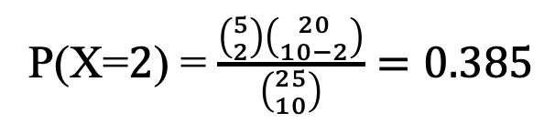
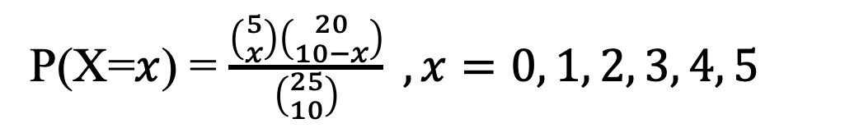
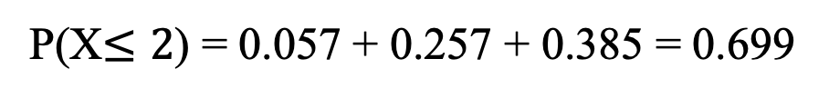
Example (cont’d)
The pmf of X is
P(X=$x$) = $\frac{\left({5 \atop x}\right)\left({20 \atop 10−x}\right)}{\left({25 \atop 10}\right)} , x=0, 1, 2, 3, 4, 5$
The probability that exactly 2 of the animals in the second sample are tagged is
P(X=$2$) = $\frac{\left({5 \atop 2}\right)\left({20 \atop 10−2}\right)}{\left({25 \atop 10}\right)}=0.385$
b. The probability that at most two of the animals in the recapture
sample are tagged is
P(X$≤2$) = 0.057 + 0.257 + 0.385 = 0.699

Slide 9
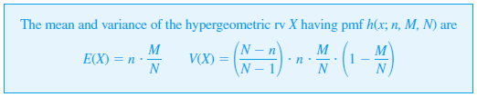
The Hypergeometric Distribution

